Slide 1
Analytics - World happiness Report 2021
Version - 1
By Wonsuk Seo

Slide 2
Why?
Recently, I was listening to the podcast talking about the confusion that 2nd generation of immigrants have. The host was a korean guy saying that being ideal life of Korean is to get the best education, jobs and good marriage. In American culture, what being successful is to find true passion on something and go for personal dream or goal. This guy from podcast led me to a question what is being successful life? And which direct I should take in order to be successful. My answer for this question is to be happy and obtain happiness from obstacles that I will be facing.

Slide 3
What
From the dataset from The World Happiness Report, I generated data analytics on which factors affect people’s happiness. It was not easy at first because it can’t be simply compared due to different systematically environments( tax rate, government) form and natural environments(weather).
The report uses six variables to measure happiness and generate the score of happiness for each country. Six variables are income, healthy life expectancy, having someone or something to rely on, generosity, freedom and trust in government.

Slide 4
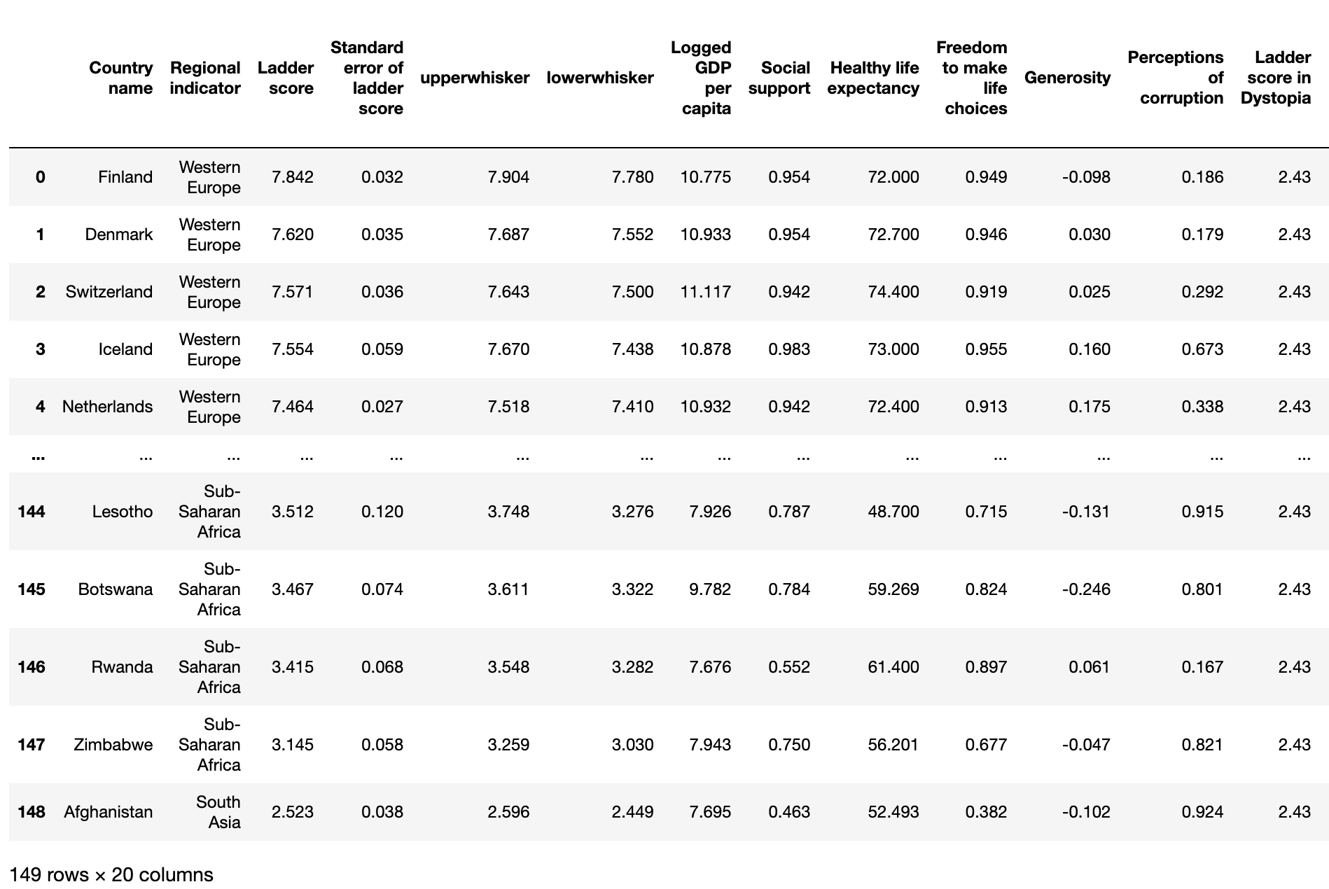
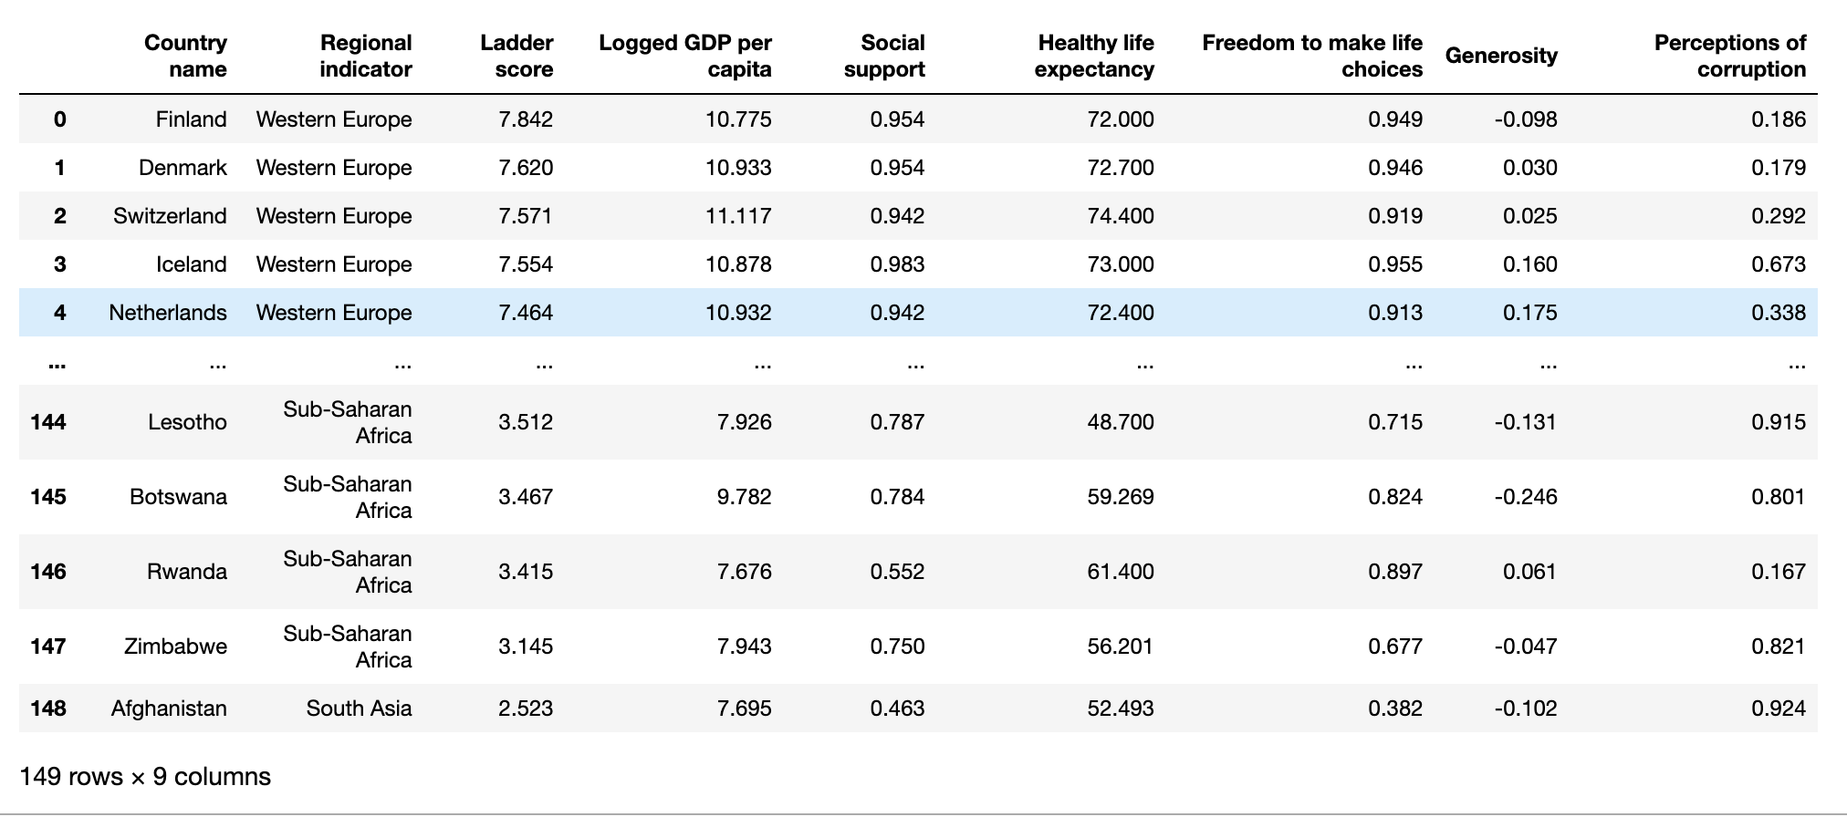
Dataframe - World happiness report 2021
I used drop function to drop unnecessary columns to gain readability of dataframe.

Slide 5
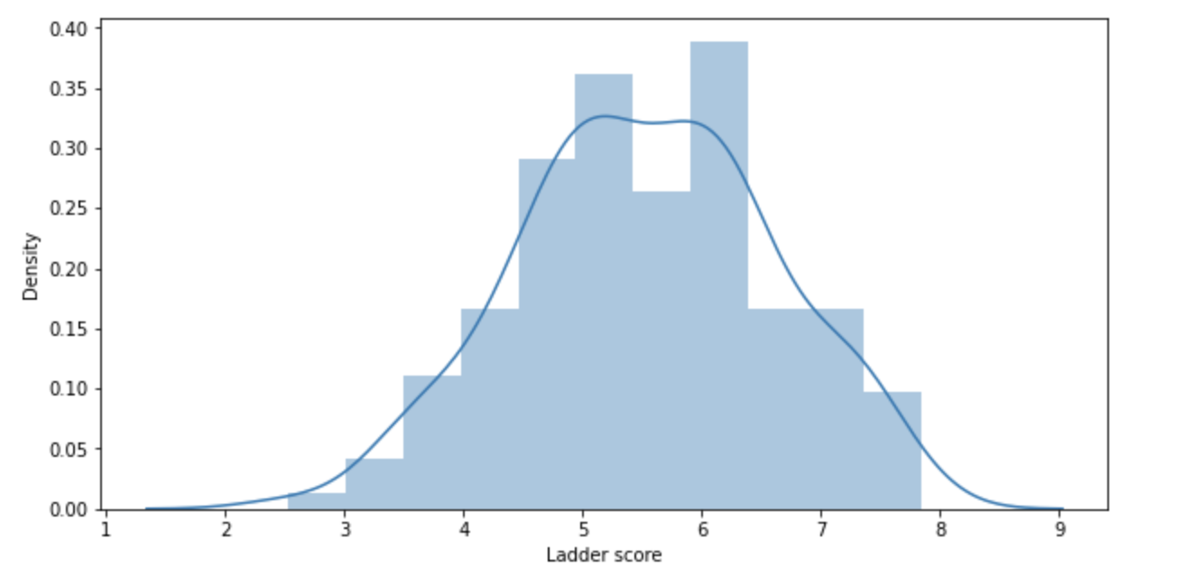
Distribution of ladder scores

Slide 6
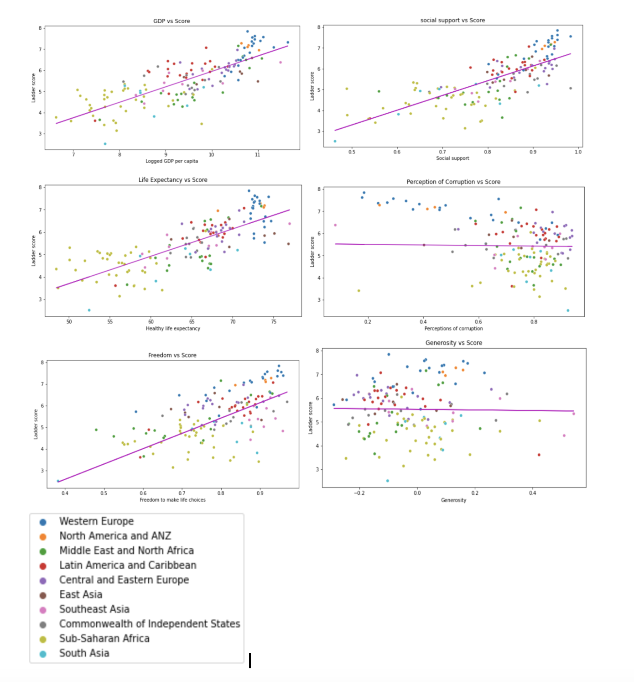
Scatter plot- Laddar Score vs variables

Slide 7
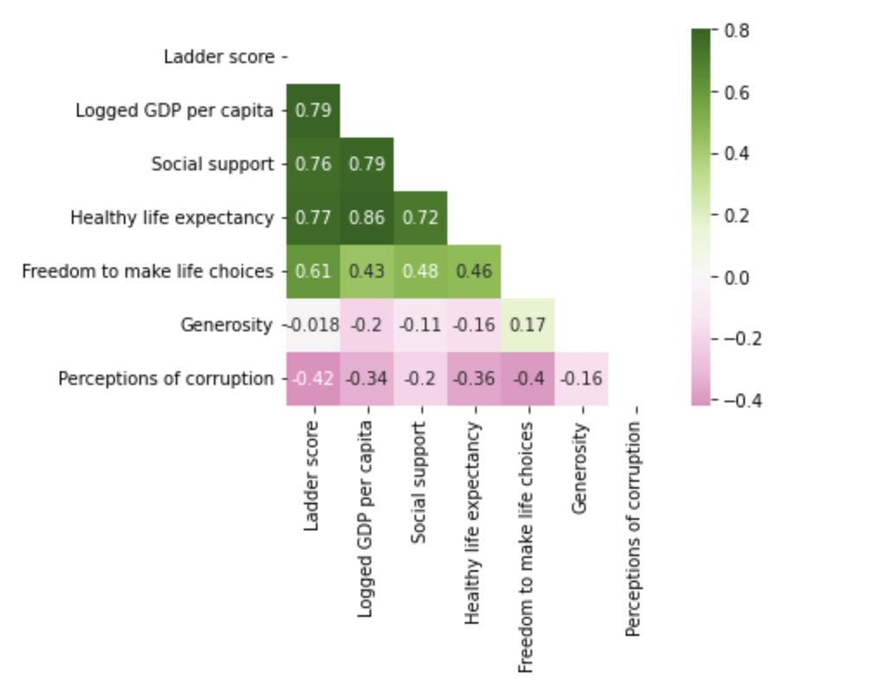
Correlation between variables
Relation ranking:
1. GDP(0.79)
2. Health(0.77)
3. Social Support(0.76)
4. Freedom(0.61
5.Perception of Corruption(-0.42)
6. Generosity(-0.018)
As you can see, some variables appear to be highly correlated with happiness, such as GDP and life expectancy.
Economy is the most determining factor, and government corruptions is far lowest.
Like I said earlier, it is hard to say that all generated results represent each countries. Therefore, I’d like to break down by regions, rich and poor countries to figure out any differences and why.
Number on each square is correlation coefficient

Slide 8
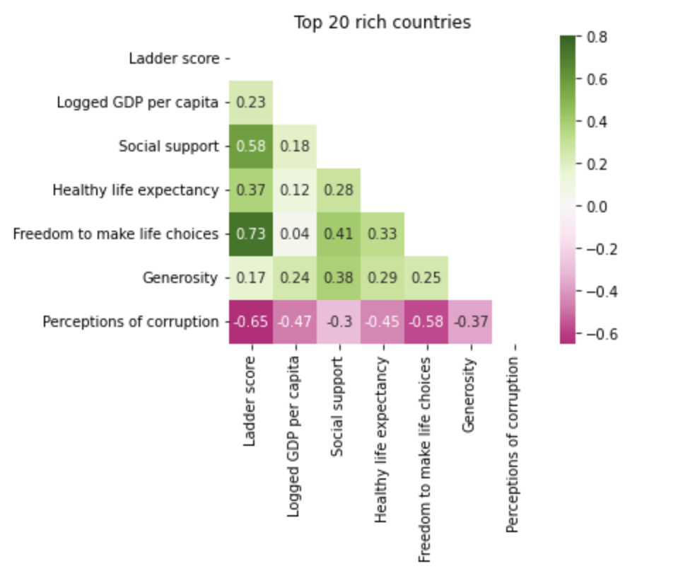
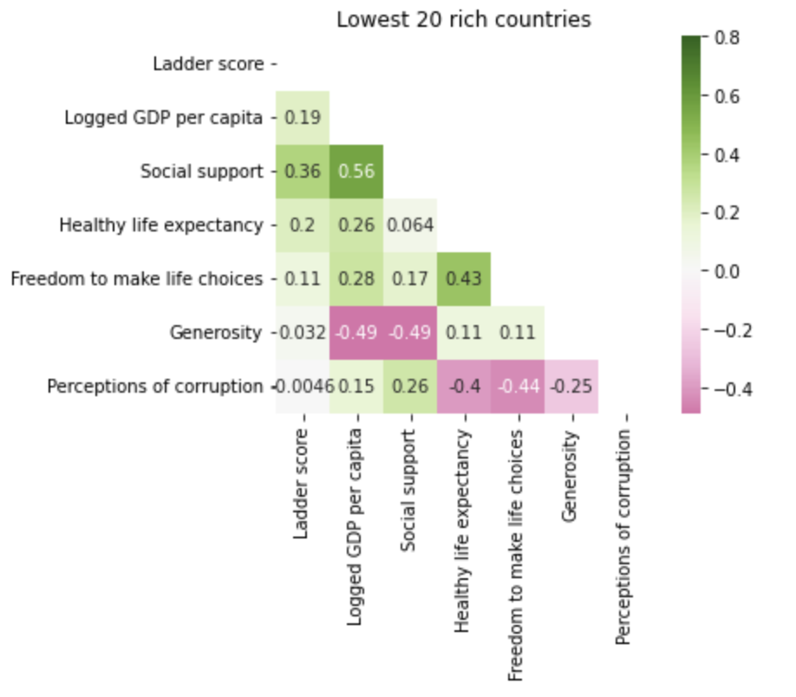
Top 2o Wealthiest VS Poorest
Relation ranking:
1. Freedom(0.73)
2. Perceptions of corruption(-0.65)
3. Social Support(0.58)
4. Health(0.37)
5. GDP(0.23)
6. Generosity(0.17)
Relation ranking:
1. Social(0.36)
2. Health(0.2)
3. GDP(0.19)
4. Freedom(0.11)
5. Generosity(0.032)
6. Perceptions of corruption(0.0046)
- Richer countries tend to have high value on Freedom than Poorer countries.
- I thought GDP might be the strong correlated factor, but in this case It is somehow related however not significant relationship does not appear.
- Poorer countries appear to be less care about Perceptions of corruption.

Slide 9
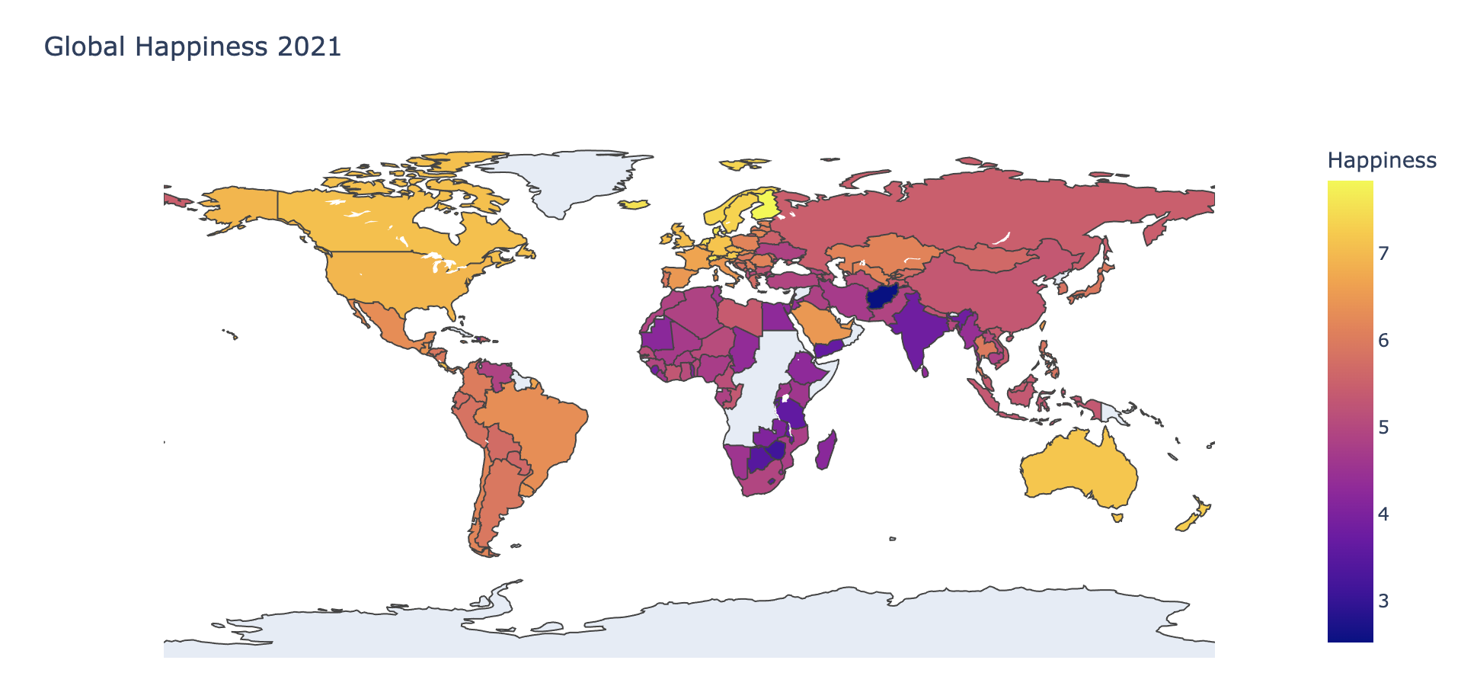
Happiness map

Slide 10
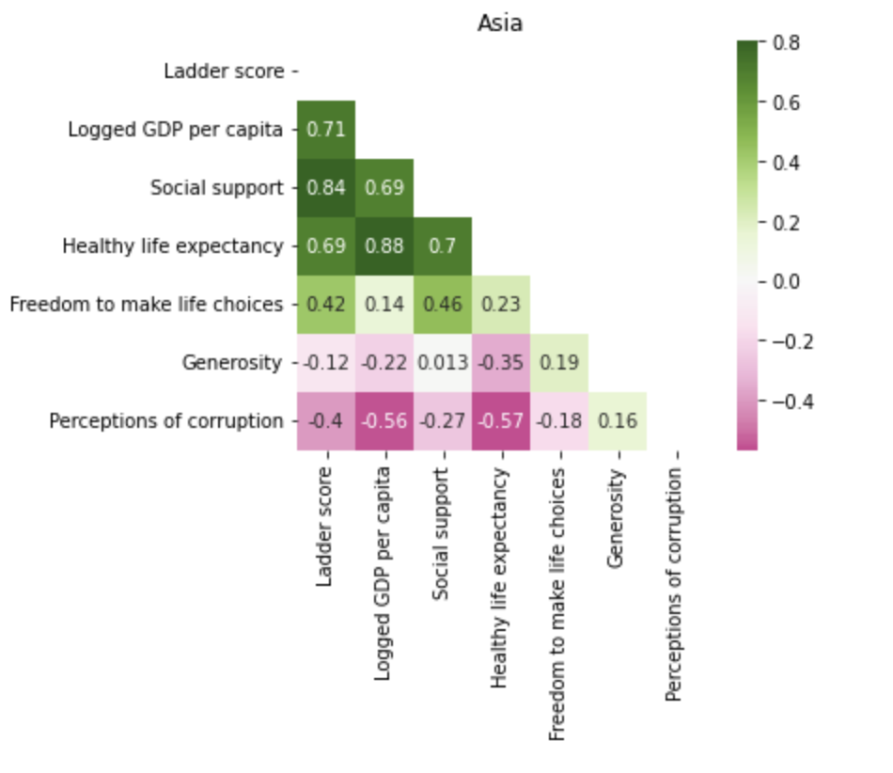
Asia
Compare to other region, Social support is the most important factor in Asia region.
Economy is also highly correlated to happiness.
Generosity is shown as the least correlated factor

Slide 11
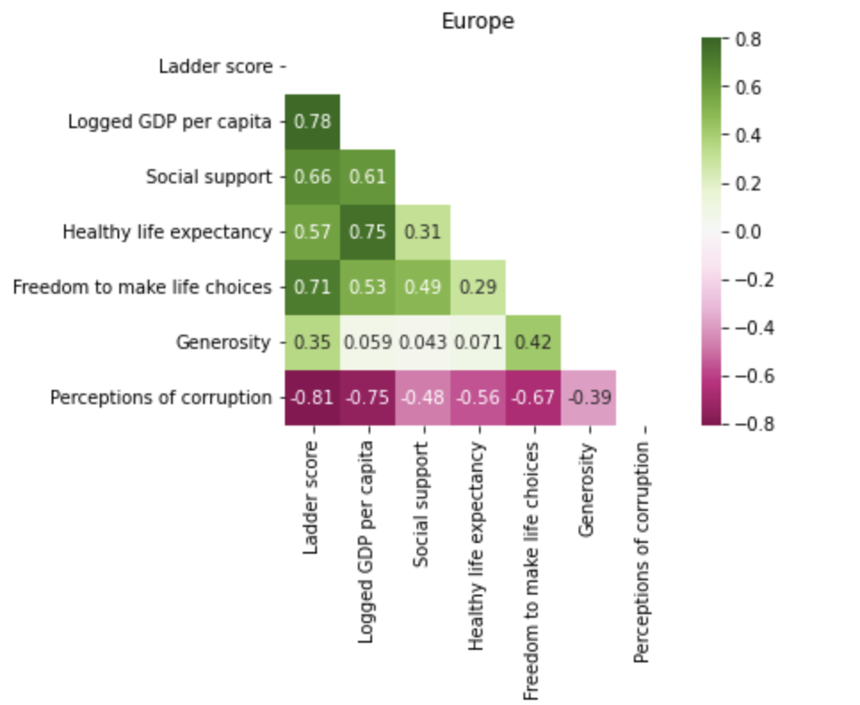
Europe
Compare to other region, Generosity is surprisingly more important factor.
Economy is also highly correlated to happiness.
PCI(perceptions of corruption index) is very important factor in Europe region, it shows that corruptions in businesses and governments affect happiness in Europe.

Slide 12
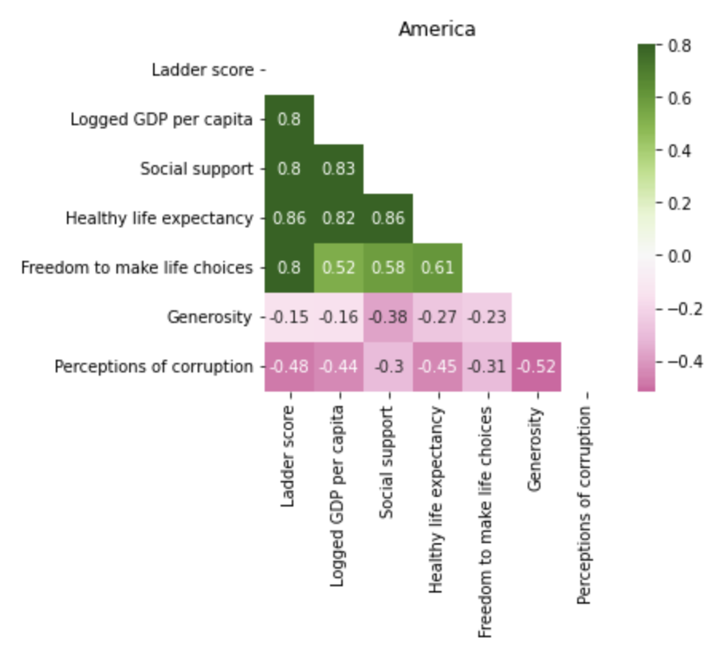
America
Compare to other region, Healthy life is the most significant factor in America region
Economy is also highly correlated to happiness.
Correlation of freedom is higer than other regions as well.

Slide 13
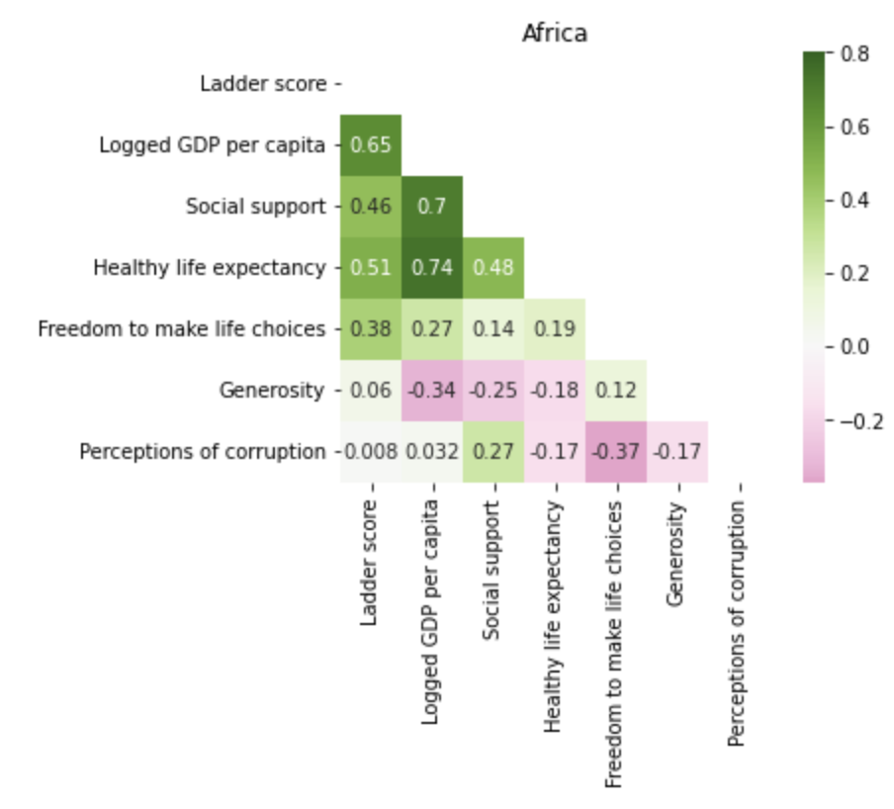
Africa
Economy is the most important factor.
Compare to other regions, Africa appear to be less mindful about corruption and it is not related to happiess.
Generosity is also not correlated as well.

Slide 14





Conclusion
Tools
From this exploratory data analysis in happiness report 2021, I found that GDP(economy) is the most import factor as I expected before.
PCI(perception of corruption index) is shown very high correlation to happiness in well economical status countries, but conversely it is very weak or no correlations in poor countries. This leads me to a question that is GDP bigger factor that it’s shown? Or what are relations between GDP and educations in poor country? It is because money or more funds for government allows to offer resources to their citizens. My next personal project would be GDP of Countries and Education.
https://github.com/BinarySeo/Happiness-report

